Slide 1

Interfaces Module
Space Systems Engineering, version 1.0
Notes:
Version 1.0
SOURCE INFORMATION:
The material contained in this lecture was developed by Lisa Guerra of NASA’s Exploration Systems Mission Directorate while on assignment in the Department of Aerospace Engineering at the University of Texas at Austin. As part of a course entitled, Space Systems Engineering, the lecture was piloted at UT-Austin in Spring 2008.
The content that follows was also reviewed and edited by Dr. Paul Graf, Adjunct Professor at the University of Colorado at Boulder.

Slide 2
Module Purpose: Interfaces
Define interfaces, how they are described and why it is important that they be managed.
Describe the most common interface tool, the N-squared diagram.
Show how N-squared diagrams can be used to:
  Capture the existence and nature of an interface
  Highlight input and output assumptions and requirements
  Demonstrate where there are feedback loops between subsystems
  Identify candidate functional allocations to subsystems
Notes:
For additional reference see the interfaces document included in the Systems Engineering curriculum materials:
NASA Reference Publication 1370, 1997
Training Manual for Elements of Interface Definition and Control
(NASA_Interface_Train-doc.pdf)

Slide 3
External Versus Internal Interfaces
System level external interface requirements are established with the other system level requirements.
So, external interface requirements, like other system functional and performance requirements, are distributed to subsystems via allocation, derivation or flow down.
Internal interface requirements are different since they are created as part of system decomposition. Different system solutions, i.e., different requirements distributions will create different subsystems and different subsystem interfaces.
  This is a powerful opportunity for the development team to optimize the system design.

Slide 4
Example External and Internal Interfaces
The interface between a spacecraft and its launch vehicle is an example of an external interface for the spacecraft development. The launch vehicle already exists so the spacecraft is developed to accommodate the existing (electrical, data, thermal and mechanical - including vibration and acoustic) interface.
For an Earth remote sensing space-based radar system, the interface between the radar sensor subsystem and the spacecraft command and data handling subsystem is an internal interface example. The development team has the flexibility to determine the mechanical, electrical, thermal and data interfaces between these two subsystems.
  So system functional and resource allocations to subsystems have implications for interface requirements. As an example, consider data compression. This function could be allocated to either the radar subsystem, the command and data handling subsystem or even the communications subsystem. Where the function is done effects the data interface (rate and format) of the subsystems down stream.
So, optimal system decomposition considers both the implications for subsystem requirements and the implications for subsystem interfaces.

Slide 5
Need for Managing Internal Interfaces
System decomposition (via requirements and functional analysis) creates a set of subsystems AND the interfaces between them.
‘Ownership’ of each subsystem is usually obvious as it is assigned to an individual or group as it is defined.
But the subsystem interfaces need special attention since each subsystem owner may assume:
  the other party is responsible for the interface, or
  each party makes its own assumptions about the interface requirements.
In both cases, the project runs the risk of future interface incompatibility, since the subsystems mature their concepts (and their interfaces) independently.
The solution is to explicitly identify the owner of every interface.

Slide 6
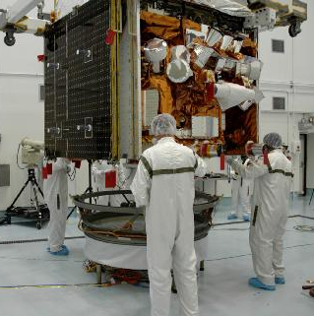
Example Interface Requirements Between the Science Instrument and Spacecraft for GLAST
Electrical
3.2.4.1 Bus Voltage The bus voltage supplied to the Science Instrument shall be 28 V +/- 6 V as seen at the input terminals of the Science Instrument.
Data
3.2.6.1.1 Interface Data Rates The Science Instrument to Spacecraft data rate shall be no greater than 70 Mbps.
Mechanical
3.2.2.2 Mass Constraint The maximum launch mass of the Science Instrument shall be constrained to 3000 kg. This is exclusive of the instrument interface structure but inclusive of any Science Instrument hardware mounted on the Spacecraft bus, such as thermal radiators and electronics boxes.
Thermal
3.2.3.4.1 Interface Temperature Ranges The interface temperature of the Science Instrument electronics boxes shall be controlled to –10 C to +40 C (TBR) operating, and –55 C to +60 C (TBR) survival.
GLAST —
Gamma-ray Large Area
Space Telescope
Launched 6/11/08
Notes:
For more on GLAST see: http://www.nasa.gov/mission_pages/GLAST/main/index.html
Source of interface requirements: Gamma-ray Large Area Space Telescope (GLAST)
Science Instrument - Spacecraft Interface Requirements Document
August 3, 1999
(See document included in SE curriculum materials: IRD_GLAST.pdf)

Slide 7
Interface Design Heuristics
In system decomposition, choose subsystems so that they are as independent as possible; that is, they have simple interfaces. As a result these subsystems will be easier to develop and test independently and when they are integrated there will be fewer problems with compatibility.
Group like functions within a subsystem. This reduces the exchange of common data and focuses development expertise.
Consider the use of standard interfaces, e.g., mechanical, electrical and data (e.g., data exchange standards from the Consultative Committee for Space Data Systems).

Slide 8
Key Interface Documents
Interface Definition Document (IDD) - defines interfaces to an existing system such as a launch vehicle. It says what interface someone else must meet to use the launch vehicle. Can be anything, such as mass, type of connector, EMI…
  Owned by manager of the system with which you want to interface
  Probably not going to change
Interface Requirement Document (IRD) - defines interfaces for two developing systems. Includes both physical and functional interfaces and ensures hardware & software compatibility.
  Jointly managed (NEEDS ONE OWNER) and signed by the managers of the two systems in development.
Interface Control
Document (ICD) -
Identifies the design
solution for the physical
interface (drawings).
Environment
Other
System
Interfaces
IRDs
System of
Interest
IDD
Other
System
LV
System
Notes:
This slide is a duplicate from the Requirements — the Basics module.
It is good to reinforce the need for these documents for a complicated space system.
The Pause & Learn Opportunity at the end of this lecture discusses a sample IRD from the GLAST mission.

Slide 9
The Most Common Interface Tool is the
N-Squared Diagram
Definition
The N-squared (N²) diagram is used to develop (sub)system interfaces. The system components or functions are placed on the diagonal; the remainder of the squares in the N x N matrix represent the interface inputs and outputs. Where a blank appears, there is no interface between the respective components or functions. The N² diagram can be taken down into successively lower levels to the component functional levels. In addition to defining the interfaces, the N² diagram also pinpoints areas where conflicts could arise in interfaces, and highlights input and output dependency assumptions and requirements.
Notes:
Source: (NASA Systems Engineering Handbook, 2007); page 54

Slide 10
Generic N-squared Diagram as an Interface Artifact
N² diagram rules:
  Items or functions are on the diagonal
  Items or functions have input and outputs
  Item or function outputs are contained in rows; inputs are contained in columns
External Input (to Item or Function 2)
Item
or
Function
1
O
O
O
1
1
1
I
2
I
3
I
4
I
1
Item
or
Function
2
O
2
O
2
O
2
I
3
I
4
I
1
I
2
Item
or
Function
3
O
3
External
Output
(from Item or
Function 3
O
3
O
3
I
4
I
1
I
2
I
3
Item
or
Function
4
O
4
O
4
O
4
I = Input
O = Output
Notes:
5 - <number>
Notes:
This illustrates the format and labeling conventions for the N² diagram.
Although this lesson uses the N² diagram to show physical interfaces, the N² diagram is useful at functional or physical level.
The N² diagram identifies entity interfaces.
The N² diagram is used by systems engineers to identify, define, and record interfaces. Project managers can use the N² diagram to manage (assign responsibility and track accomplishment of) the interfaces.

Slide 11
Identify Subsystem Feedback Loops and Candidate Subsystem Boundaries
If there is bi-directional information flow between functions - this is a feedback loop.
In this example there are feedback loops between functions 1 & 2 and 2 & 3.
Consider combining functions where there is a lot of ‘coupling’ (including feedback loops) within a subsystem. This may simplify the subsystem designs and their interfaces.
External Input (to Item or Function 2)
Function
1
O
1
I
2
I
1
Function
2
O
2
O
2
I
3
I
1
I
2
Function
3
External
Output
(from Item or
Function 3
O
3
O
3
I
1
Function
4
O
4
I = Input
O = Output
Notes:
5 - <number>

Slide 12
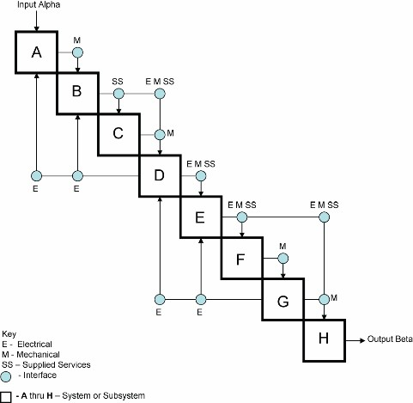
Example N-Squared Diagram
Notes:
Source: From: NASA SE Handbook, 2007; appendix F p 289

Slide 13
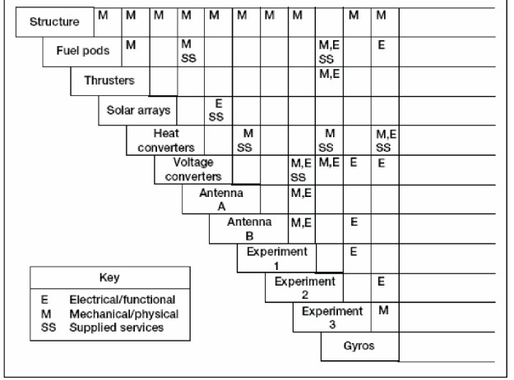
Spacecraft N-squared Diagram Captures the Existence and Type of Subsystem Interfaces
Notes:
N² Diagrams
An N-Squared (N²) diagram is a matrix representation of functional and/or physical interfaces between elements of a system at a particular hierarchical level.
Hardware interface example on previous slide:
The system components are placed on the diagonal.
The remainder of the squares in the N x N matrix represent the interfaces.
The square at the intersection of a row and a column contains a description of the interface between the two components represented on that row and that column. For example, the solar arrays have a mechanical (M) interface with the structure and an electrical (E) interface and supplied service (SS) interface with the voltage converters.
Where a blank appears there is no interface between the respective components.
The N² chart can be taken down into successively lower levels to the hardware and software component functional levels.
In addition to defining the data that must be supplied across the interface, by showing the data flows the N² chart pinpoints areas where conflicts could arise in interfaces, and highlights input and output dependency assumptions and requirements.

Slide 14
TDRS N² Diagram With Information Interfaces
User
Request
Typical
External
Input
• Payload Data
• Status
and
• S/C Status
• S/C Ranging
Output
TDRS
Remote Ground Station
• S/C Data
• Status
Physical Entities on Diagonal
Requests
• S/C
• Schedules
Data Satellite System
• Data Products
• Schedule Req
Commands
• Directives
• Schedules
• S/C Vectors
• S/C
• Performance
• S/C Commands
Commands
Reports and
(STS)
User Data Report
Summaries
• Directives
• User Needs
• Data Request
Primary Users
• Status
• Surface Truth
• Schedules
• TDRS Status
• Directives
• Conf Schedule
Relay Control
• S/C Vectors
• TDRS Vectors
• S/C Commands
• S/C Ranging
(STS Only)
• S/C Data
TDRS = Tracking and Data Relay Satellite S/C = Spacecraft
Notes:
5 - <number>
Notes:
N² diagrams are two dimensional models showing interfaces. The intersections are used to identify the interfaces. This identification is a depiction of interfaces and a tool in allocating interfaces to lower level entities. N² diagrams are read in a clockwise fashion: Output from Entity A to Entity B, Output from Entity B to Entity A.
In the example, there is a Payload Data Space Craft (S/C) Status output from TDRS and input to the Data Satellite System. There is an S/C Commands output from the Data Satellite System, provided as an input to the TDRS. There are no interfaces between TDRS and the Remote Ground Station.
At the system level, there are interfaces and associated interface requirements levied on the system. On the above diagram, external interfaces to the system are depicted as external entries and exits from the block. As architecture solution entities are identified, internal interfaces and requirements are identified. These are shown in the N² diagram at the intersection blocks.

Slide 15
In-Seat Exercise
Allocating interface requirements
Identify the interfaces in the N² diagram
Human
Push
Button
Remote
Control
Unit
Keyboard
Display
RF Signal
Audio
& Video
Television
Notes:
5 - <number>

Slide 16
Pause and Learn Opportunity
Review the sample Interface Requirements Document from the GLAST mission. (IRD_GLAST.pdf)
Understand the need for such interface documents.
Point out:
Use of definitions
Spacecraft to Instrument requirements
GLAST N² charts

Slide 17
Module Summary: N² and Interfaces
System external interfaces are defined, distributed and managed like other system requirements.
Internal interfaces, since they are created as the system is decomposed, can be optimized by the development team.
In developing interfaces group like functions, keep them simple and consider the use of standard interfaces.
Since all interfaces run the risk of being ignored as development teams focus on their subsystem responsibilities, explicitly identify the owners of all interfaces.
N-squared diagrams the most common interface identification and management tool. They are are used to:
  Capture the existence and nature of an interface
  Highlight input and output assumptions and requirements
  Demonstrate where there are feedback loops between subsystems
  Identify candidate functional allocations to subsystems

Slide 18
Backup Slides for Interfaces Module

Slide 19
Managing Technical Interfaces
  Interface Specifications (IS) and Interface Control Documents (ICD):
  Firm agreement between two parties
  Need an IS or ICD for each external partner and often for internal partners
  Each IS or ICD may specify multiple interface requirements
NASA
Partner
How formal do these need to be?
Notes:
9903
Notes:
Properly working interfaces are essential for the integration of subsystems and external systems. Strict control is needed. The interfaces are identified on the left side of the Vee during requirements development (external system interfaces using the CONOPS as a driving artifact) and during concept and architecture development (internal system interfaces derived from architecture decomposition). Once identified, interfaces must be defined and managed. Interface Control Documents and Interface Specifications are tools for interface management.
The “Interface Specification” is “the specification that defines the physical, functional, and operational characteristics of the interfaces between entities of a system.” It is the management tool that is used to structure an agreement between parties of a shared interface.
The Interface Control Document (ICD) is another term for Interface Specification, and sometimes is used to refer to a collection of interface specifications between two interfacing organizations.
The form of the agreement will vary, depending on the relationships that exist between the parties. This ranges from ‘oral and a handshake’ to contractual, signed agreements. However, a best practice is to ensure that the agreement is recorded, and that changes require approval and are also recorded.

Slide 20
Managing Interfaces – Interface Control Working Group (ICWG)
Purpose and role
  Focus on solution interfaces - both external and internal
  Participating partners on the ICWG
  Under change management authority
  Conflict resolution
  Maintain interface integrity - synchronization of changes with documentation
Managing Interface Agreements
  Documenting the interface is critical
  Agreement between the partners is essential
  May include many interfaces
  Evaluate the impacts of proposed changes
  Closely manage the agreement – it is a contract between the interfacing parties
Notes:
9903
Notes:
In systems with large numbers of interfaces, a dedicated group called the Interface Control Working Group (ICWG) can be used to manage the interfaces of the system. This specialized group typically contains representatives from both sides of the interface (technical and management). The ICWG purpose is to maintain the integrity of the interfaces by ensuring:
Parties on both sides of the interface are working to the same interface baseline,
All system changes are evaluated for impact to interface, and
No interface changes are accepted without formal approval on both sides of the interface.
The ICWG usually reports to the Change Control Board and is typically the sponsor for changes to system interfaces.
ICWGs can manage associate contractor interfaces.
ICWGs can establish authority for resolving differences in the way ICDs are understood.

Slide 21
Scope Elements - Definitions
Interfaces
External interfaces form the boundaries between the system-of-interest and the rest of the world.
Ask the following questions about each boundary to the system-of-interest:
  What does the system do to/for the world?
  What does the world do to/for the system?
  What is the worst thing that can happen across this interface?
  Is the interface likely to change during the development of the system?
  Is this interface likely to change after the system is in use?
It is useful to create an external interface diagram to the system-of-interest.
Document every industry standard or Interface Control Document (ICD) that exists for the external interfaces.
Interface verification check questions:
  Have you identified and documented all product interfaces?
  Have you created a mechanism to monitor interface changes outside your control?
  Have you involved people from the other side of the external interface?
  Have you simplified interfaces as much as possible?

Slide 22
The N² Diagram*
System
Input
1 | I₁₂ | I₁₃ | I₁₄ | I₁₅ | I₁₆
I₂₁ | 2 | I₂₃ | I₂₄ | I₂₅ | I₂₆
I₃₁ | I₃₂ | 3 | I₃₄ | I₃₅ | I₃₆
I₄₁ | I₄₂ | I₄₃ | 4 | I₄₅ | I₄₆
I₅₁ | I₅₂ | I₅₃ | I₅₄ | 5 | I₅₆
I₆₁ | I₆₂ | I₆₃ | I₆₄ | I₆₅ | 6
Constructing an N² Diagram
The system components (1-6 in this case) are placed on the diagonal.
The outputs from each component are placed in the horizontal rows.
The inputs to each component are placed in the vertical columns.
System
Output
* Also known as design structure matrix.

Slide 23
Allocating Interface Requirements
  Decomposition into lower-level entities establishes interfaces between those entities.
  External interface requirements must be satisfied by the entity or allocated to lower-level entities.
  Interfaces between lower-level entities must be specified.
  Specify only to the extent required.
Build in and maintain options as long as possible in the design and implementation of complex systems. You will need them.
Notes:
Notes:
Interfaces, like requirements and functions, must be satisfied by the entity or allocated to lower level solution entities. Partitioning the higher level entity also creates interfaces, which must be allocated to the lower level solution entities.
When specifying interfaces, specify only to the level required. For example, when interfacing to an existing external system, all required details of that interface must be specified and flowed down. When internal interfaces are created, specify only to identify the need for the interface. Allow the solution entity designers flexibility to work out the best implementation for their entities.
Interface design information may be included in the design artifact information at the current level or may be contained in a separate document called an Interface Specification. On large programs involving multiple organizations, a separate document is preferred for this information, since it holds the information in a consolidated place, making maintenance more manageable.
The Art of Systems Architecting, Maier & Rechtin; CRC Press 2000; page 29:
Build in and maintain options as long as possible in the design and implementation of complex systems. You will need them.

